Slide 1
TITLE:
Named entity recognition (NER)
TEAM MEMBERS:
Manichand_2010030455
HARSHa_2010030173
PRAKASH _2010030533
Dileep _2010030416

Slide 2
Table of Contents
ABSTRACT
Project Area
Literature Survey
Problem Statement
Objectives
Motivation
Dataset
techniques
Conclusion
references
Suggestions
Thank you

Slide 3
With the increase in availability of data, extraction of useful information from this data has become most important activity across all domains. When the data is available as documents written in natural language, information extraction becomes more challenging. Named Entity recognition (NER) is a technique used extensively for automatic extraction of useful information from unstructured natural language document collections. Used both, for web applications as well as stand-alone systems, NER is considered as one of the major step in Natural Language Processing (NLP) for analysis of text. This paper discusses basics of NER, various algorithms used for NER and major applications and challenges in the field of NER.
Keywords: Named Entity Recognition, Information Extraction, Natural Language Processing, Part of Speech.
ABSTRACT:

Slide 4
In natural language processing, named entity recognition (NER) is the problem of recognizing and extracting specific types of entities in text. Such as people or place names. In fact, any concrete “thing” that has a name. At any level of specificity. Job titles, public school names, sport names, music album names, musician names, music genres.
PROBLEM
AREA:

Slide 5
We did a literature review from several textbooks, tutorials, and papers.
Textbook:
After going through the IR textbook, we found no chapters or sections explicitly introduce how to do
NER. The term NER is mentioned only two times in Chapter 10 and Chapter 15.
We also checked other two famous NLP text books, “Foundation of Statistical NLP” and “Speech and Language Processing”.
Papers and Tutorials:
We also found a few good papers about NER. A survey of existing NER technologies is presented by Nadeau and Sekine [1]. Zhou and Su [2] proposed a HMM-based chunk tagger for NER. Ratinov and Roth [3] investigated the common challenges and misconceptions in NER, and proposed corresponding solutions.
Reference : https://vtechworks.lib.vt.edu/bitstream/handle/10919/52254/ReportNER.pdf
Literature
Survey

Slide 6
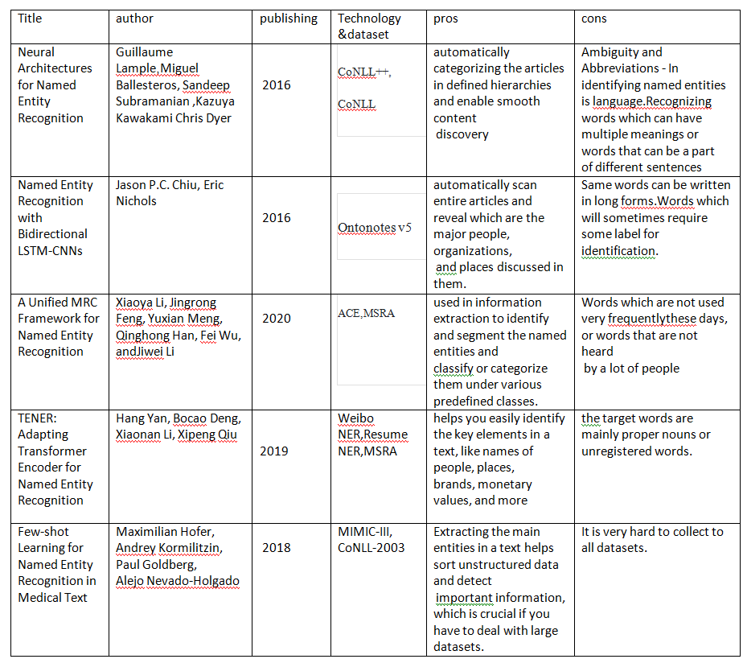

Slide 7
Named Entity Recognition (NER) is a natural language processing task that attempts to find named entities (persons, locations, organizations, etc.) within a text. Since the tag of one word depends on neighboring words (and their tags), the problem is modeled as a sequence labeling task, wherein a sentence is considered as an input, and the goal is to produce the tags of all words jointly, so as to maximize accuracy.
PROBLEM STATEMENT:

Slide 8
The primary objective is to locate and classify named entities in text into predefined categories such as the names of persons, organizations, locations, events, expressions of times, quantities, monetary values, percentages, etc.
Extracting the main entities in a text helps sort unstructured data and detect important information in less time.
Objectives

Slide 9
NER plays a vital role in reference resolution, disambiguation, representation of meaning etc, in other natural language processing applications. Semantic parsers and part of speech taggers can be extended with this type of tagging to provide better results. An understanding of named entities involved in a text or document at any level will provide efficient analytical frameworks and cross-referencing.
Motivation

Slide 10
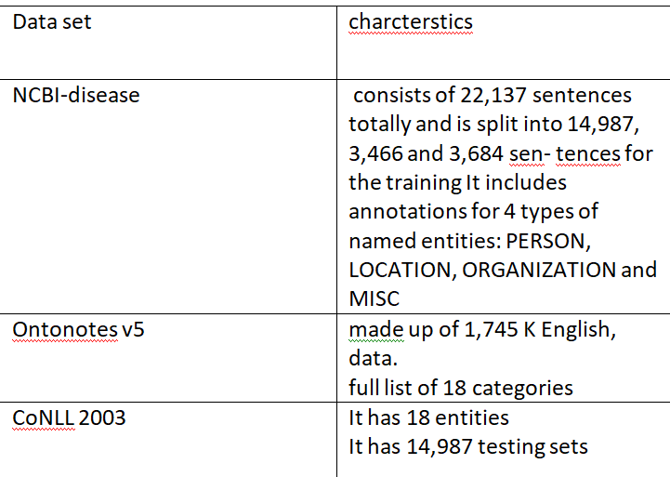
DATASET

Slide 11
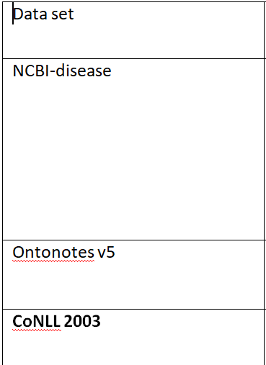
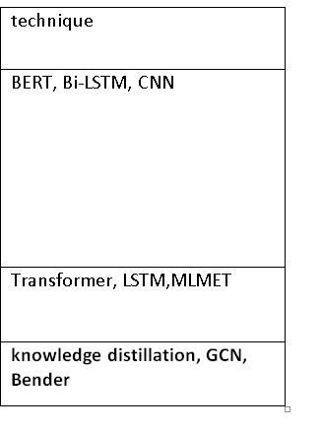
techniques

Slide 12
Named Entity Recognition, a sub process of natural language processing, plays very important role in automated information extraction NER is suited to any situation in which a high-level overview of a large quantity of text is helpful. With NER, you can, at a glance, understand the subject or theme of a body of text and quickly group texts based on their relevancy or similarity..
Conclusion:

Slide 13
BERT:
Lee, Jinhyuk, Wonjin Yoon, Sungdong Kim, Donghyeon Kim, Sunkyu Kim, Chan Ho So, and Jaewoo Kang. "BioBERT: a pre-trained biomedical language representation model for biomedical text mining." Bioinformatics 36, no. 4 (2020): 1234-1240.
Transformer:-
Xu, Lu, Zhanming Jie, Wei Lu, and Lidong Bing. "Better Feature Integration for Named Entity Recognition." arXiv preprint arXiv:2104.05316 (2021).
knowledge distillation:-
Zhou, Wenxuan, and Muhao Chen. "Learning from Noisy Labels for Entity-Centric Information Extraction." arXiv preprint arXiv:2104.08656 (2021).
References

Slide 14
Bi-LSTM:-
Jang, Beakcheol, Myeonghwi Kim, Gaspard Harerimana, Sang-ug Kang, and Jong Wook Kim. "Bi-LSTM model to increase accuracy in text classification: Combining Word2vec CNN and attention mechanism." Applied Sciences 10, no. 17 (2020): 5841.
CNN:-
Zhu, Qile, Xiaolin Li, Ana Conesa, and Cécile Pereira. "GRAM-CNN: a deep learning approach with local context for named entity recognition in biomedical text." Bioinformatics 34, no. 9 (2018): 1547-1554.
LSTM:-
Cho, Minsoo, Jihwan Ha, Chihyun Park, and Sanghyun Park. "Combinatorial feature embedding based on CNN and LSTM for biomedical named entity recognition." Journal of biomedical informatics 103 (2020): 103381.
References

Slide 15
MLMET:-
Dai, Hongliang, Yangqiu Song, and Haixun Wang. "Ultra-Fine Entity Typing with Weak Supervision from a Masked Language Model." arXiv preprint arXiv:2106.04098 (2021).
GCN :-
Seti, Xieraili, Aishan Wumaier, Turgen Yibulayin, Diliyaer Paerhati, Lulu Wang, and Alimu Saimaiti. "Named-entity recognition in sports field based on a character-level graph convolutional network." Information 11, no. 1 (2020): 30.
Bender:-
Li, Jing, Aixin Sun, Jianglei Han, and Chenliang Li. "A survey on deep learning for named entity recognition." IEEE Transactions on Knowledge and Data Engineering (2020).
References

Slide 16
THANK YOU

